Slide 1
Task: Build a Team Page
Your task is to implement the “team page” design. We want to get a sense of how you would approach building this page using what is included in the task folder. You will find a .jpg mockup along with the source file designed in Sketch. The images and company logo are included too. Don’t worry about matching the fonts included on the mockup. Just do your best to mock the design!
Please email the completed project to khoungbeke@upperquadrant.com and kpearlman@upperquadrant.com

Slide 2
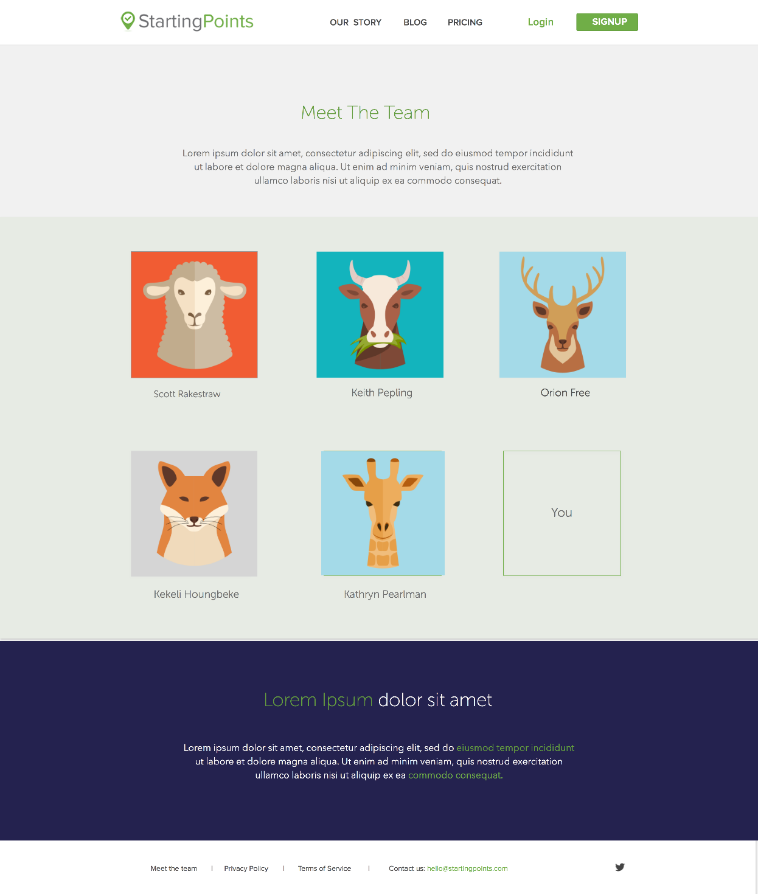
D | Route | Area | Page / Topic | Section | State | POV | Lock Date
 |  | Marketing | View | Team | Normal | Any
The purpose of this page is to provide a personal touch to the site to help it stand out, to increase trust among visitors by providing faces to the names, and to express that the people behind the company are our most important resource.
1
5
6
7
8
9
Elements
Nav bar with company name/logo
Text areas
Photo for each team member
Footer
Actions
Our Story – return to main page
Blog – link to blog
Pricing – link to pricing page
Login – goes to login page
Signup – goes to signup page
Footer: links to privacy policy, terms of service, email the team, and Twitter
2
1
5
6
2
7
3
3
8
4
9
10
3
Rules
Use blank links for Our Story, Blog, Pricing, Login, Signup, Privacy Policy, Terms of Service, Contact Us, and Twitter
Bonus Tasks (optional)
Make the design responsive so it works on mobile and tablet as well
Do something fun with the photos to show how you’d include short team bios or other information for each team member
2
4
10

